Slide 1
Capturing the Spread of Hate on Twitter using Spreading Activation Models
International Conference on Complex Networks, 2021

Slide 2
Hate Speech on Online Social Media : The Problem
Online Social Media platforms are excessively being used for the dissemination of Hateful content.
The cycle of creation, propagation, and consumption of Hate Speech has to be intervened upon to mitigate its adverse effects.
Hate Speech, by definition, is a targeted attack towards a person or group’s identity, cultural or political sentiment, and the ideas or opinions they resonate with.
Hate, further, is not a blanket category, and exists parallely through intertwining of several forms. These forms may be categorized as Racism, Xenophobia, etc.

Slide 3
Current Approaches to tackle the problem [Contd.]
Ribeiro et al. [10] find that instead of the general assumption that hateful users are alone, they are actually central in their social network.
Mathew et al. [11] present a study of hate and counterspeech accounts on Twitter.
Wu et al. [12] studies spread hateful content on Gab (gab.com), which hosts a multitude of hateful content. They find that hateful users in their dataset are very densely connected and are responsible for a significant number of posts generated in Gab, despite being small in number.

Slide 4
Our Proposition
We improve the existing classification of hateful tweets on the dataset used
We propose SPA based model for capturing the influence of hateful users in turning other users hateful
We analyze the topics present in the hateful tweets and observe interesting patterns
We modify the existing TopSPA model to capture the spread of hateful tweets
We empirically demonstrate that SPA based model captures the influence mechanism very well
We also show that the modified TopSPA model accurately captures the spread of hateful tweets

Slide 5
Dataset
We use the dataset provided by [10]. This dataset contains 200 most recent tweets of 100, 386 users, totaling to around 19M tweets.
It also contains a retweet induced graph of the users with 2, 286, 592 directed edges.
Out of the 100,386 users, labels (hateful or normal) are available for 4, 972 users, out of which 544 users are labelled as hateful and the rest as normal.
Though the original dataset does not have labels for the tweet content, we use it for two reasons, a) it is the largest collection of users marked as hateful and b) it gives us an opportunity to analyse the retweet-induced graph structure.

Slide 6
Our Approach
Classification
SPA
Topic Modelling
TopSPA
Binary classification of 19M tweets into hateful/ non-hateful using an Ensemble of 2 Machine Learning models trained on separate hate speech data.
Select seed users based on the percentage of tweets classified as hateful; select appropriate time segments; and run the Spreading Activation Algorithm
Run a Topic Modelling Algorithm to obtain the latent topics in the tweets classified as hateful
Run the SPA model for each topic separately, by selecting seed users and the dissipation factor dynamically for each topic

Slide 7
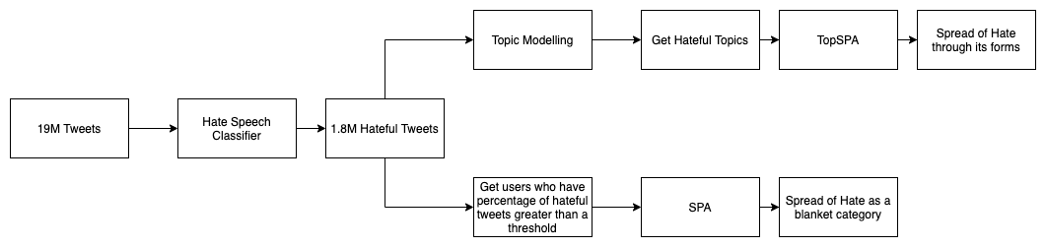
Our Approach [Contd.]

Slide 8
Ensemble based Hate Classification
We use datasets from two different domains, i.e. from toxic comments and hateful tweets. Model A learns from the dataset of toxic comments, while model B learns from tweets with hate speech against immigrants and women. This ensures the hate classifier is trained with the diverse aspects of hate.
Both models A and B consist of logistic regression classifier on top of Naive Bayes log count ratio as features.
We normalize the prediction probabilities given separately by the 2 models and pick the tweets which rank > 0.3 as hateful.
We classify a user as hateful if they have more than 50% of their tweets classified as hateful.

Slide 9
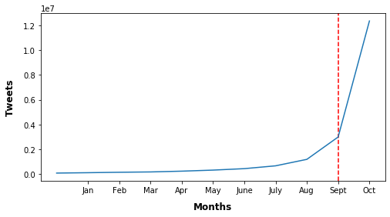
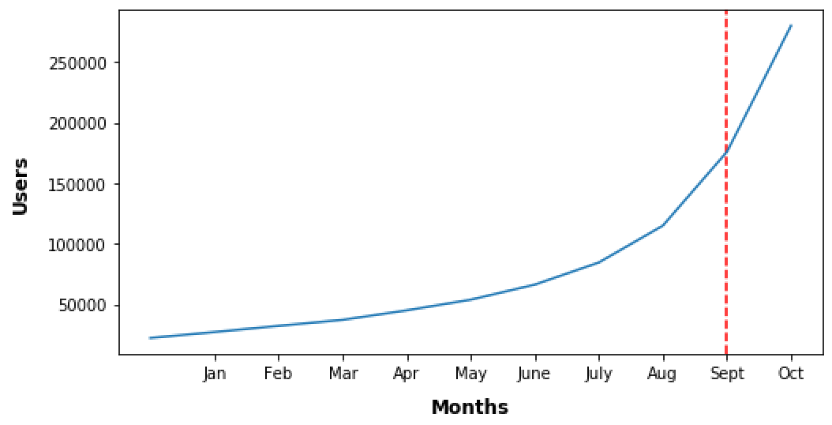
Segmenting the Data Temporally
The distribution of the posts and the users who have made the posts is very skewed temporally.
We analyse the data at per month granularity to select the first time segment from January to September, and the remaining months for the second time segment.
We find 50,032 unique users in this first segment with 3, 51, 318 edges in the retweet induced subgraph.

Slide 10
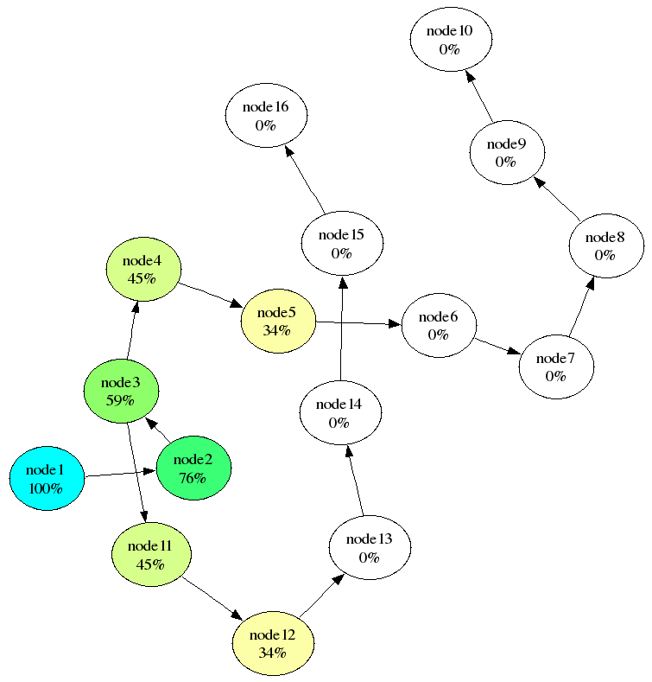
SPA - Spreading Activation Models
SPA is an iterative process; given a directed weighted graph G = (V, E) , it starts with a few nodes as seed nodes that are initialized with some initial energy.
In every iteration, each activated node passes a fraction of its energy to its directed neighbors, that is determined by the dissipation factor and the edge weight.
A node is activated when it’s total energy received goes above a threshold. The process terminates when no new nodes are activated, or a steady activation state with respect to some delta is reached, or when a maximum number of iterations is exceeded.
In this example, spreading activation originated at node 1 which has an initial activation value of 1.0 (100%). Each link has the same weight value of 0.9. The decay factor was 0.85. Four cycles of spreading activation have occurred. Color hue and saturation indicate different activation values. [13]

Slide 11


Evaluation Metrics
For prediction set {A} and Ground truth set {B}, we measure two metrics
Precision
Jaccard Coefficient

Slide 12
Tuning the model parameters for traditional SPA
Decay Factor Selection : The decay factor d determines how much energy a node allows to flow in the system. We vary d as 0.1, 0.3, 0.5 and 0.7
Seed User Selection : We pick users from the time segment T1, who have a percentage of hateful tweets greater than 50%
d | Precision |  |  |  | Jac
% | 10 | 20 | 30 | 40 | 10 | 20 | 30 | 40
0.1 | 0.2628 | 0.3629 | 0.4424 | 0.5200 | 0.1512 | 0.2216 | 0.2840 | 0.3514
0.3 | 0.2324 | 0.3379 | 0.4222 | 0.5041 | 0.1315 | 0.2033 | 0.2674 | 0.3370
0.5 | 0.1782 | 0.2974 | 0.3919 | 0.4813 | 0.0980 | 0.1750 | 0.2437 | 0.3170
0.7 | 0.134 | 0.2533 | 0.3537 | 0.4530 | 0.0718 | 0.1450 | 0.2145 | 0.2929

Slide 13
Topic Modelling
We use a latent topic detection technique called LDA to detect the latent topics present in a tweet.
We explore two variants of sampling for LDA, a) variational Bayes sampling method and b) Gibbs Sampling.
Due to tweets being short in length and large in number, scaling of LDA to detect topics where every tweet is treated as one document is very challenging.
Therefore, we create one document per user by concatenating all his posts, which includes tweets, retweets and quotes to obtain a topic affinity vector for each document (or user).

Slide 14
Topic Modelling Results
In order to select α and the number of topics, we perform a grid search where we vary alpha between 0.1 and 0.01 and the number of topics from 6 to 12. The number of iterations for each run is 500. We update the alpha and beta parameters every 10th iteration.
We experiment with large numbers such as 15 and 20 but observe that the produced topics have relatively less coherence and a high overlap as compared to a smaller number of topics. Hence, we vary the number of topics from 7 to 10 as 7, 8 and 10.
We find that the best performing topic model, which has both a high coherence score and the least number of overlapping topics, is when α = 0.1 and number of topics equal to 8.

Slide 15
TopSPA
Hate has multiple forms as mentioned earlier. We hypothesise that instead of modelling the spread of hate as a blanket category, we should model the spread of hate in a form that also factors in the topics/hate forms present in the hateful tweets. Therefore, we decide to borrow the existing TopSPA model to model the spread of hateful tweets with respect to each topic.
TopSPA is an iterative process that is carried out per topic and the initial energy represents the initial affinity of the user to the topic. The total energy accumulated by a given vertex at the end of the process will indicate the topical information received.

Slide 16
Tuning the model parameters for modified TopSPA
Decay Factor Selection : We hypothesize that hateful topics are different from regular topics. A hateful user with respect to a topic keeps retweeting/quoting the hateful tweets belonging to the topic. Therefore, we keep d constant for each node in our approach and experiment with multiple values of d to get better precision.
Seed User Selection : Our seed user selection takes into account the nature of the topics from general public’s perspective. We keep the affinity threshold dynamic across the topics for selecting seed users. This helps in ensuring the topics which are widely discussed and not many users show very strong affinity, a suitable set of seed users is selected. The motivation to do so is derived from the distributions of user and tweets w.r.t. topic affinity as shown on the next slide.

Slide 17
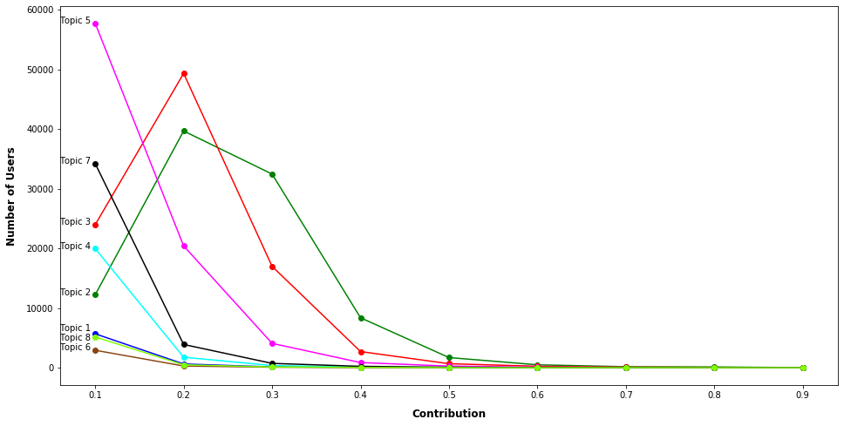
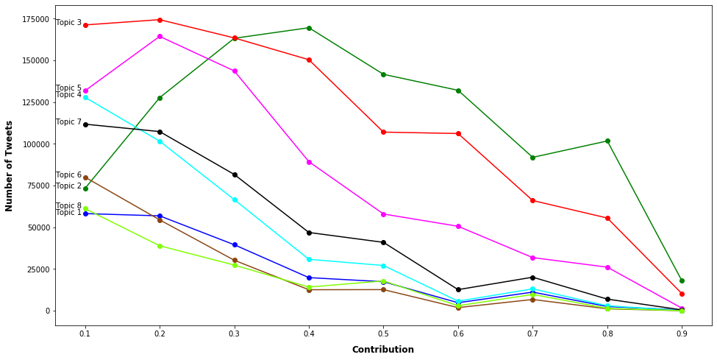
Affinity of users and tweets with respect to the topics present

Slide 18
Modified TopSPA Results
Initially, we select seed users with an uniform threshold of 0.5 with respect to the topic affinity for a user but we realize that a uniform threshold does not perform so well on a few topics. We discover that the number of seeds users in these topics are much less compare to the total users. We also find these topics are more generic in nature.
It is evident that many tweets show strong association with the topics 1, 6 and 8. Therefore, we decide to have a dynamic threshold for topic affinity, catering to each topic for seed user selection.

Slide 19
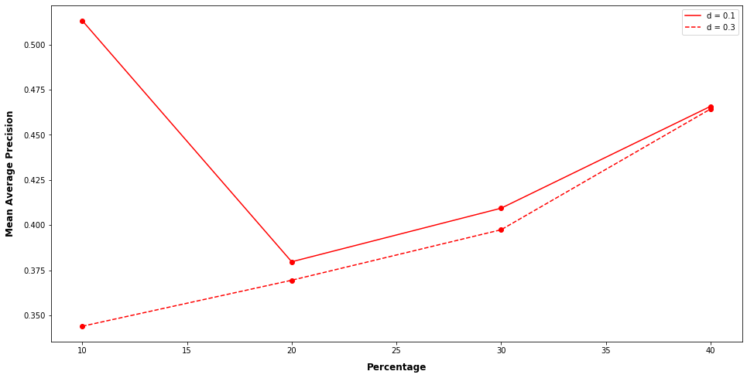
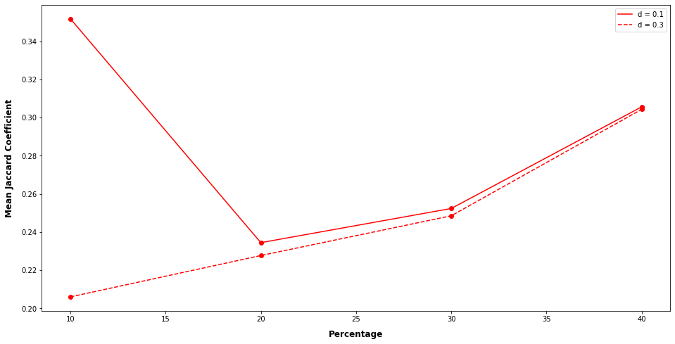
Modified TopSPA Results [Contd.]
We compute dynamic affinity values for seed selection across multiple topics in such a way that we get a reasonable number (at least 5% of total users) of seed users.
We also vary the decay factor d as 0.1 and 0.3 for the dynamic affinity values.
We see that TopSPA also gives best results for lower values of d.

Slide 20
Discussions
Most of the existing works on hate speech detection use hate as a singular category. We find that not to be true and observe that hate is a combination of different forms targeting different subjects.
Though keeping d constant in our experiments gives us better results on our dataset, experimenting with dynamic values of d that incorporate user information such as receptiveness to different forms of hate, how active a user is in the network and modelling external factors is an important area to explore.
Topic modelling on hateful tweets shows us the different topics present in a primarily hateful discourse. We observe topics which can be tagged as relating to politics, hate against race, against women and xenophobia. We tag these topics by the top words that appear in these topics. A better approach can be to use deep learning models to train a multi-label classifier to validate these findings.

